Slide 1
#
Sales Forecast Funnel Tool
Usage of Agentic Workflows
FutureTech | VWITS

Slide 2
Overview
Understanding
Proposed Methodology
Sales Funnel Forecast Tool that ingests data from multiple sources into AWS, with potential time lags in preparation.
Forecasting model integrates Prophet for seasonality and XGBoost for predictive accuracy.
Explainability is crucial, especially in feature importance to build trust and improve user acceptance
Leverage transformed data to develop tools that enhance explainability using LIME/SHAP etc..
Design and implement agents for qualitative, quantitative analysis, and explainable AI (XAI).
Develop an agent-based workflow to generate explainable and actionable insights, accessible via interactive dashboards.
Assumptions
Value Proposition
Business definitions/data-dictionary is consistent, and readily available for easy understanding.
Stable data transformation pipeline exists.
Required model artifacts are available.
Agentic workflows to enhance decision making by augmenting qualitative and quantitative analysis to the explainable analysis.
AI-powered explainable insights with actionable recommendations through visual dashboards.
As a future scope, forecast fine-tuning by performing the What-if-Analysis simulations

Slide 3
Reference Data
Data Ingestion
Transformation and Analysis
Output / Customer Facing
Macroeconomics
Data Transformation
Prophet
XGBoost
Sales Forecast
Feature Importance Tools
Dashboard
Purchase Motivation
XAI Based Agent
LIME
Feature Heatmap Dashboard
SHAP
Tools
Array of SHAP/LIME coefficients for individual features
What-If-Analysis Agent
<Digital Twin>
Customer Interactions
Qualitative Analysis Agent
Tools
Time Serries
Feature Information Summarizer
Forecast Summary
Quantitative Analysis Agent
AI Agents
Tools
Proposed Solution
Planned for Future

Slide 4
Raw data output
Shap output
API
User Input
LLM Agents flow

Slide 5
Agent Responsibilities
Quantitative Analysis Agent
Responsible to perform the exploratory data analysis and summarize it in natural language
Tools:
Causal Analysis Tool
Data Drift Monitor
Pandas Profiling
Multi-collinearity
Etc…
Output:
How each quantitative features are behaving
“The price of the raw material has increased by 2% from the last quarter.”
Qualitative Analysis Agent
Responsible for doing the analysis of key business insights and sentiments in the market
Tools:
Sentiment Analyzer
Market trends
Motivation drivers analysis
Etc…
Output:
How the information in the media is perceived.
“New regulations may impact the supply chain and potentially impact our Q3 sales projection.”
XAI Based Agent
Responsible for the identification of important features contributing to the Sales Forecast
Tools:
LIME (or)
SHAP
Etc.
Output:
Identification of marginal contribution of each feature towards the forecast.
{“market_launch”: 0.06, “google_seach_index”: 0.1, “oil_electricity_price”: -0.2….}
Feature Information Summarizer
Responsible for the aggregation of feature summaries from all the analytical agents
Tools:
Visual interpretation
Summarizer
Etc.
Output:
Explain which feature was important and contributed to the Sales forecast and why. And potentially also provide recommendation.

Slide 6
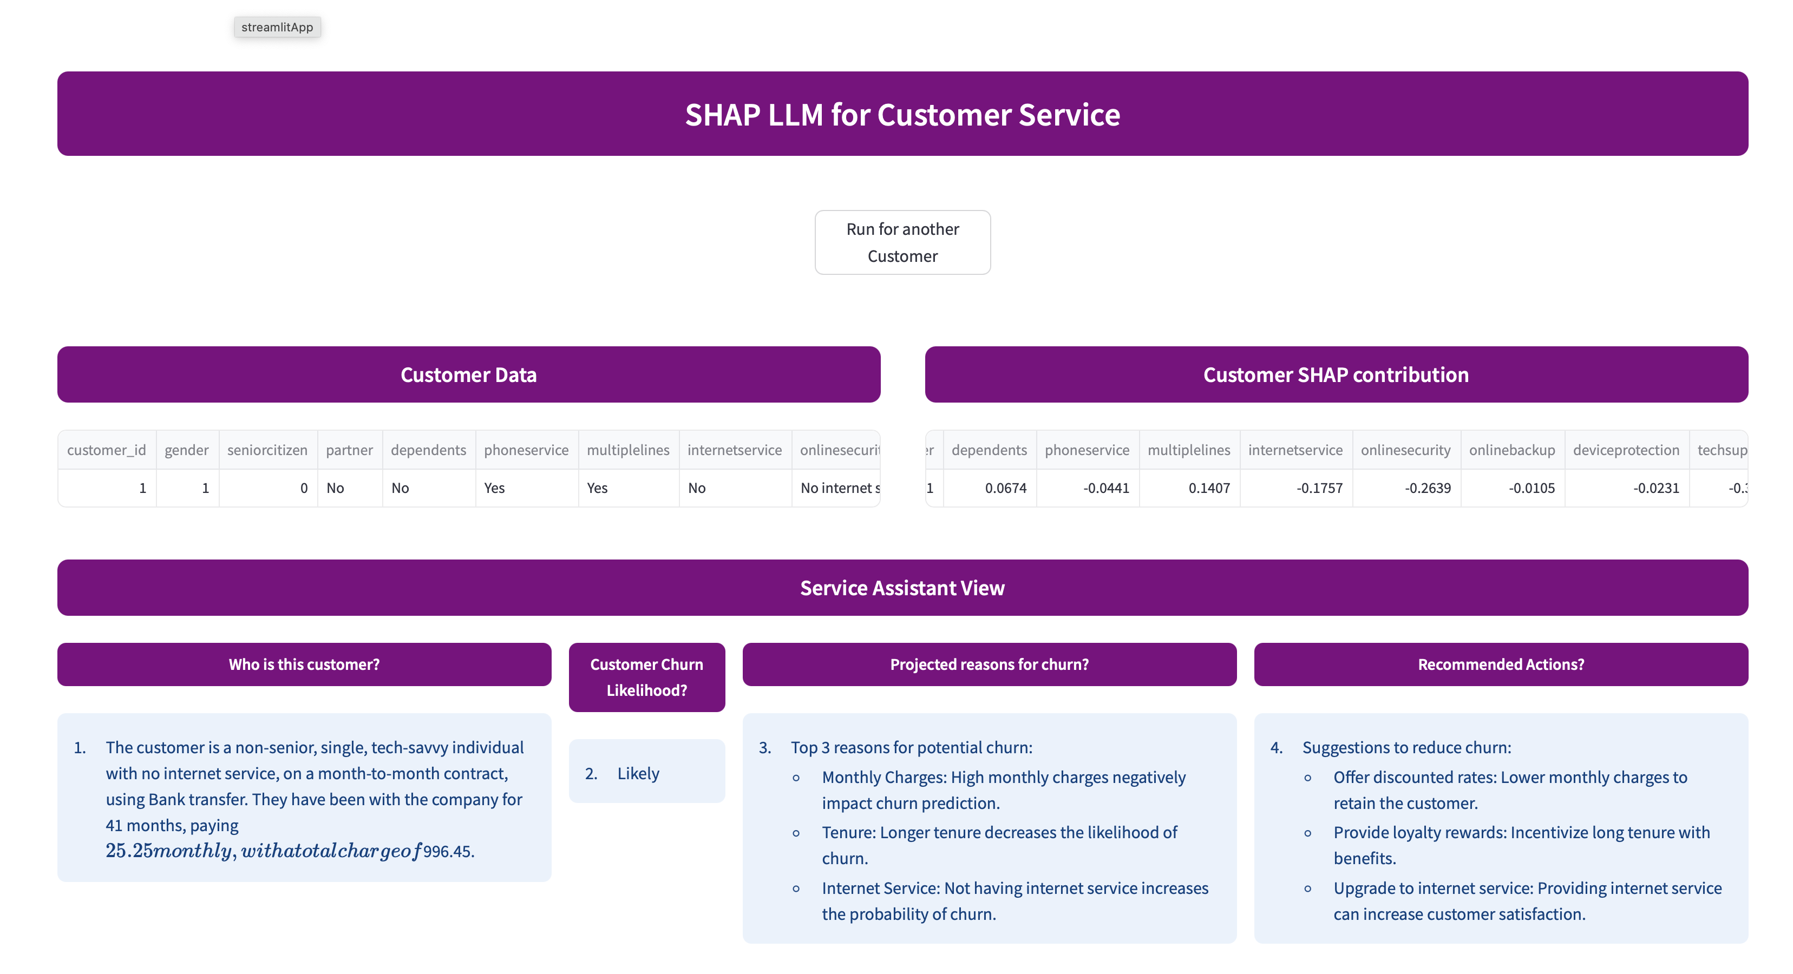
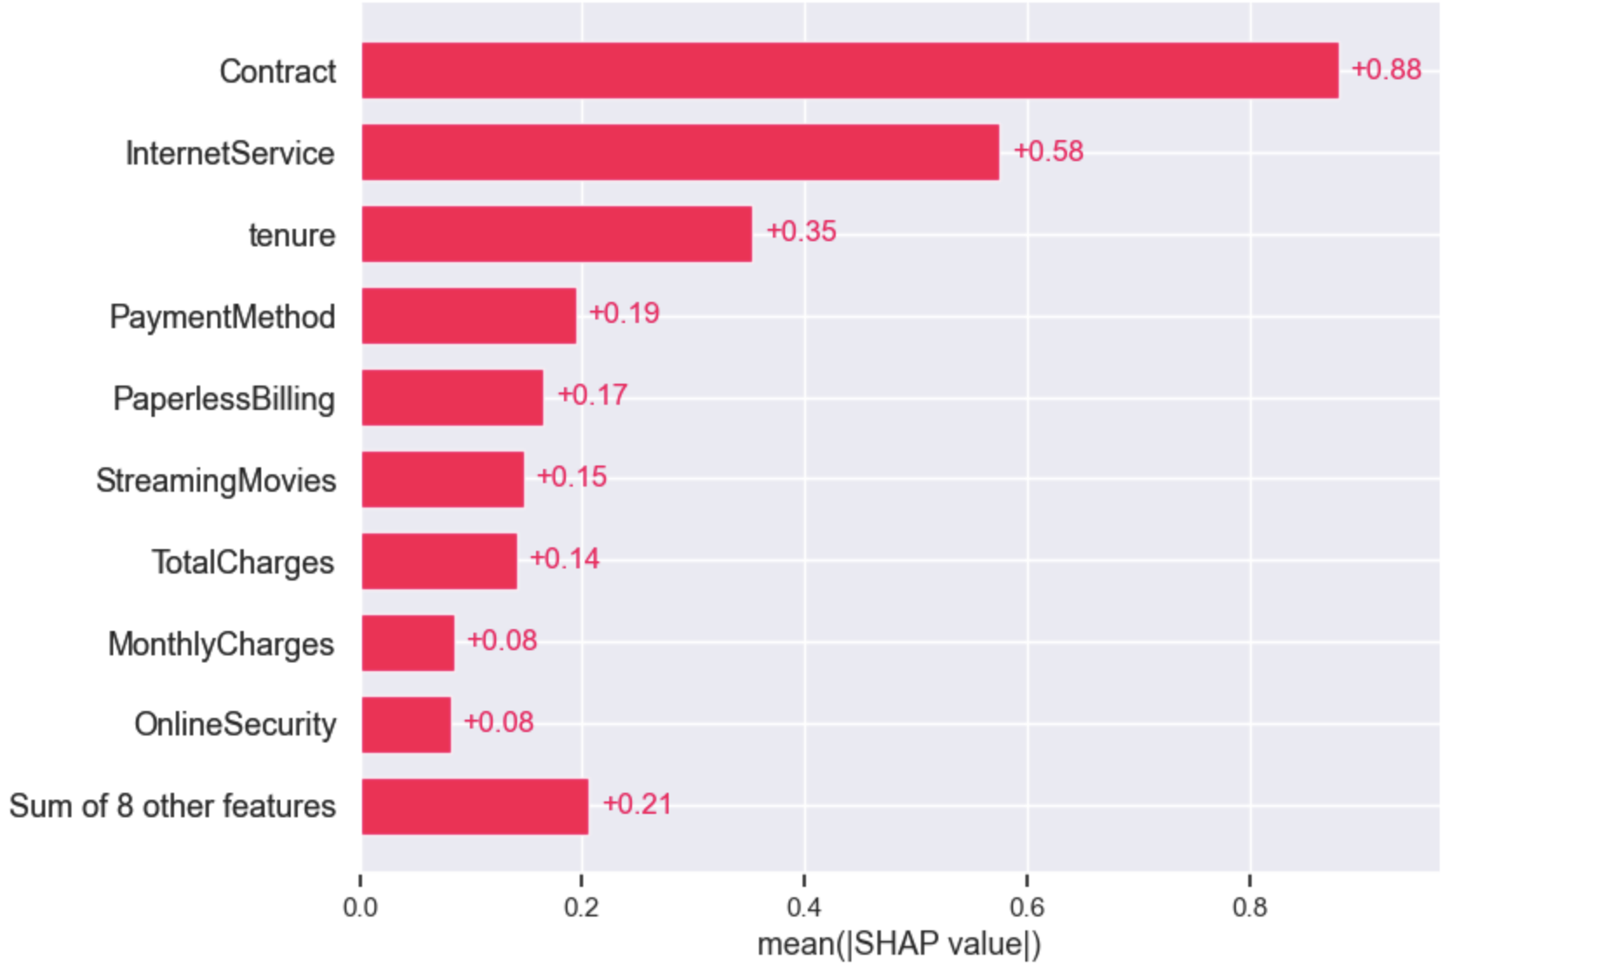
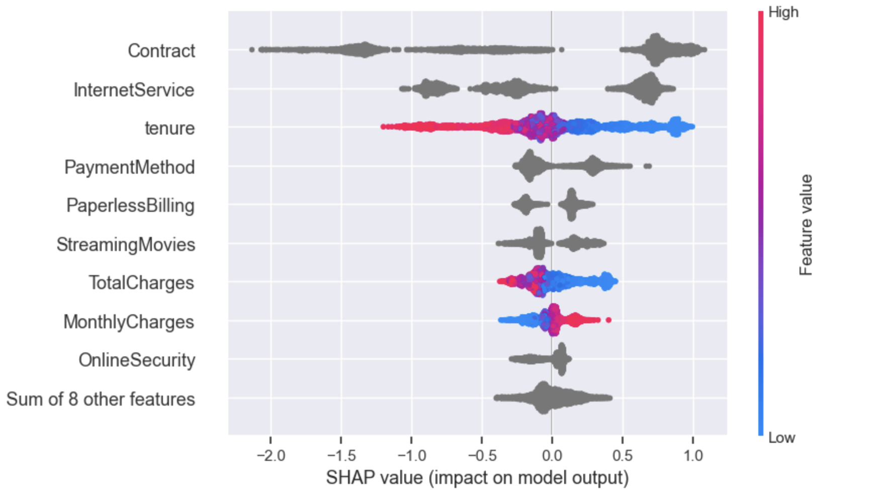
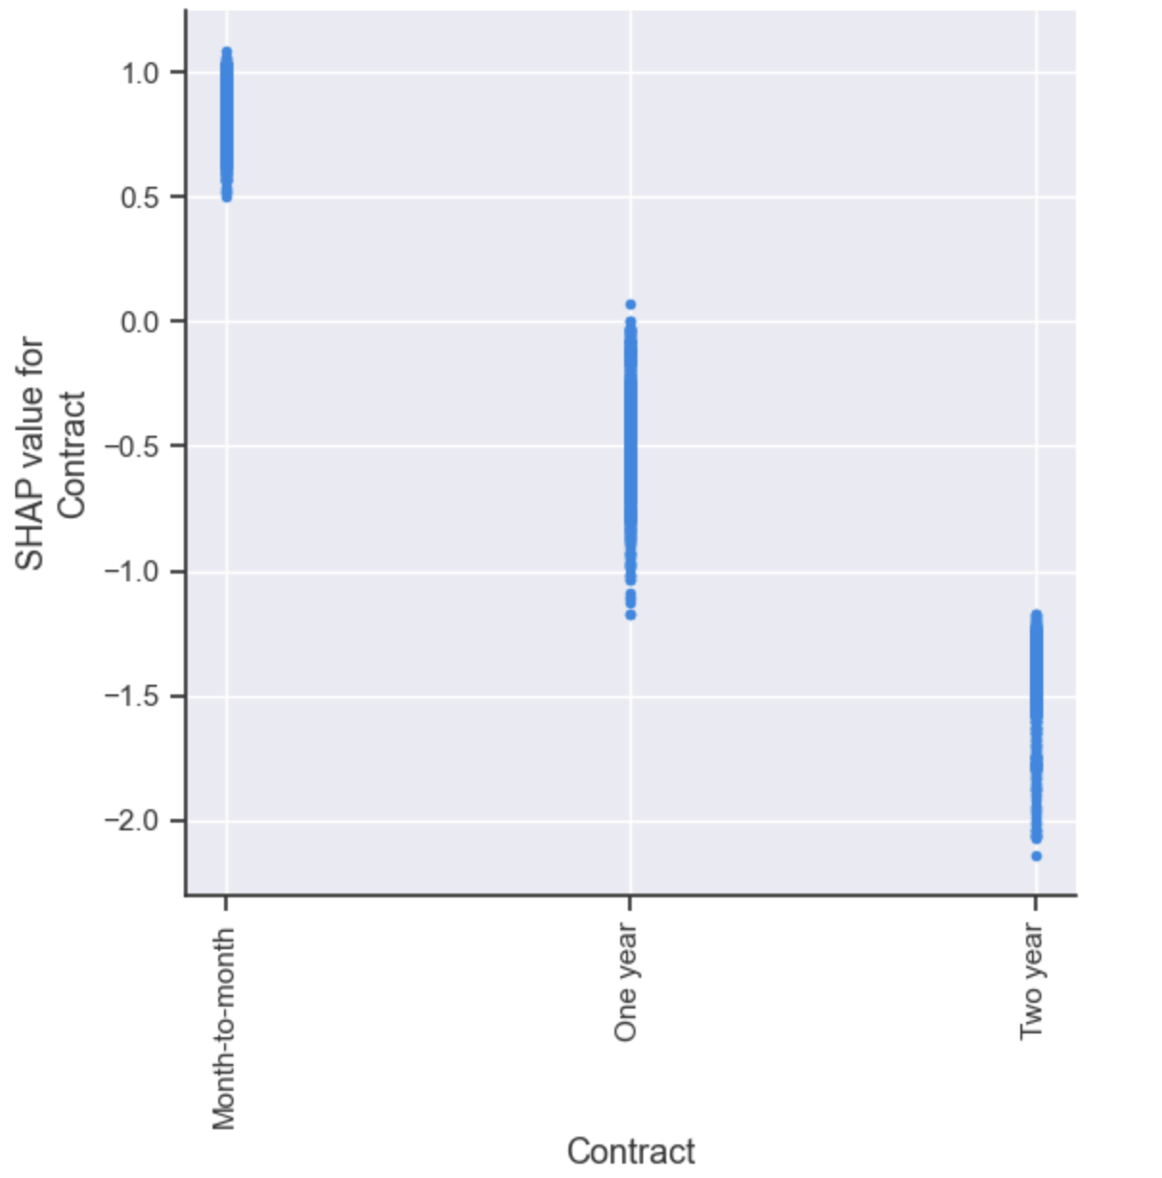
Dashboard - Reference

Slide 7
Thank You!

